Slide 1
Tapioca
Simona Godálová

Slide 2
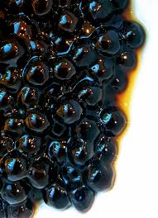
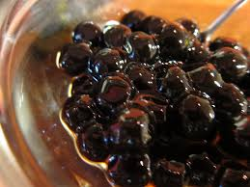
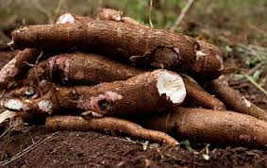
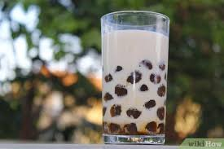
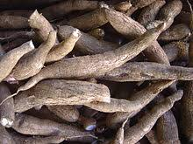
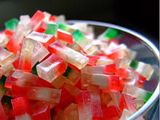
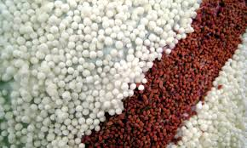
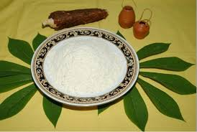
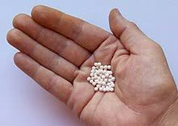
Tapioca

Slide 3
Tapioca
Tapioca is a starch extracted from the storage roots of the cassava plant , a species native to the north region and central-west region of Brazil, but whose use is now spread throughout South America.
The plant was brought by the Portuguese to much of West Indies, Africa and Asia. It is a perennial shrub adapted to the hot conditions of tropical lowlands. Cassava copes better with poor soils than many other food plants.Tapioca is derived from the word tipi'óka, its name in the Tupí language spoken by natives when the Portuguese first arrived in the Northeast Region of Brazil around 1500.
This Tupí word is translated as 'sediment' or 'coagulant' and refers to the curd-like starch sediment that is obtained in the extraction process.The low amylose and low residual content, combined with the high molecular weight of its amylose, make tapioca a useful starting material for modification into a variety of specialty products.
Tapioca starch applications in specialty products has become increasingly popular. The effects of additives on thermal transitions and physical and chemical properties can affect the quality and storage stability of tapioca-based products.

Slide 4
Thank you !

